Slide 1










Market Basket Analysis on
Orders
GA Capstone Project by Chan Ying Jie
Credits to https://slidesgo.com/ for the slide template

Slide 2
Problem Statement
Knowing which products customers commonly purchase together can help Instacart with retail strategies
Formulate discounts for bundle purchases to increase sales
Items frequently bought together can be located near one another to improve logistics efficiency

Slide 3
Data Source and Description of Data
Extracted from: https://www.kaggle.com/competitions/instacart-market-basket-analysis/data
Aisles which products can be found in
Dataset containing orders of all users. Each observation contains one product_id tagged to the corresponding order_id
Mapping of order_id to order details including user_id, day of week and hour of day when order was placed
Aisles.csv
Order_products.csv
Orders.csv
Departments.csv
Products.csv
Departments which products belong to
Mapping of product_id to product details such as product name, aisle_id and department_id

Slide 4

Random sampling of data (10%)
01
02
03
04
Main dataset: order_products.csv
One observation contains only one product, so one order_id with 10 products would span across 10 observations
But we want to get all the products in the same order for market basket analysis
Generate list of all order ids
Take 10% random
sample of ids
Select all observations corresponding to each of the order ids in the chosen sample

Slide 5
Characteristics of Instacart data
334,608
Number of different orders after taking 10% random sample
1
134
3
Number of different product aisles
49,688
Number of different products sold
2
20
4
Number of different product departments

Slide 6

Exploratory Data Analysis

Slide 7
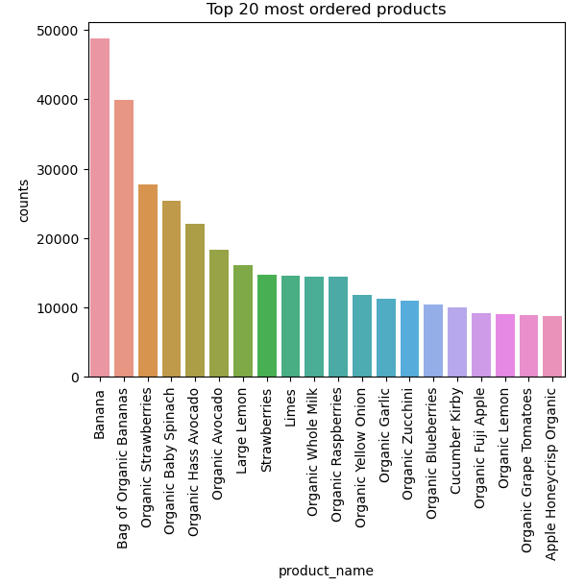
What are the top 20 most ordered products?
The most popular products ordered on Instacart are bananas, strawberries and baby spinach.
The rest of the products are a variety of other fruits and vegetables, as well as organic whole milk.
It appears that Instacart customers are pretty health-conscious!
Notes:
The most popular products on Instacart are bananas, strawberries and baby spinach.

Slide 8
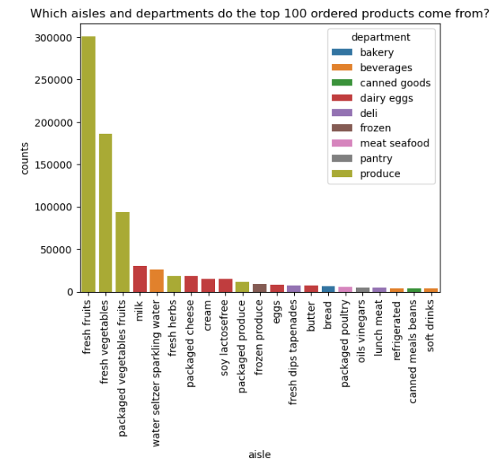
Breakdown of top 100 products by aisle and department
Most of the ordered products come from the produce department, followed by the dairy & eggs department.
3 aisles in the beverages department also feature in the graph, namely water seltzer sparkling water, refrigerated beverages and soft drinks.
Notes:
### From the graph, we can see that most of the ordered products come from the produce department, followed by the dairy & eggs department
### 3 aisles in the beverages department also feature in the graph, namely water seltzer sparkling water, refrigerated beverages and soft drinks.

Slide 9
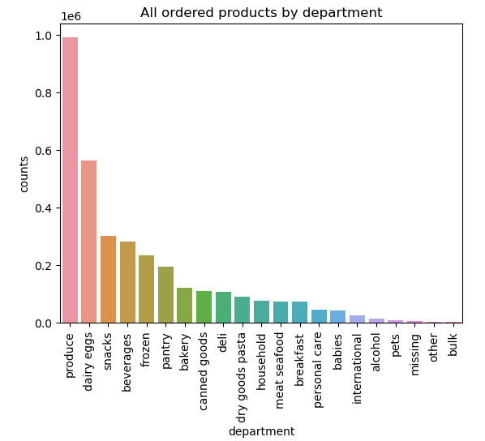
Across all ordered products, which departments are they under?
Consolidating across all orders, the top 5 departments are:
Produce
Dairy & eggs
Snacks
Beverages
Frozen food
Instacart also sells baby and pet products!
Notes:
### Consolidating across all orders, the top five departments are produce, dairy eggs, snacks, beverages and frozen food.
### Another interesting finding is that Instacart also sells baby and pet products.

Slide 10
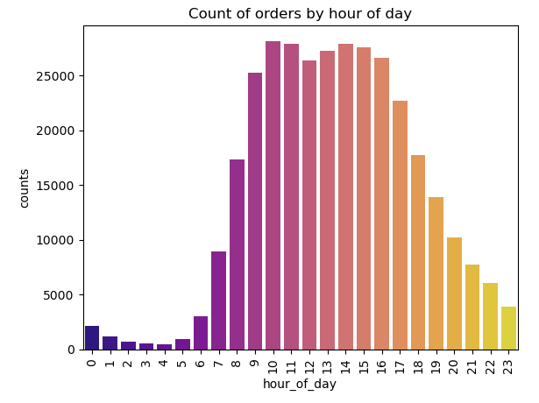
What is the breakdown of orders throughout the day?
Most orders are placed between 9am to 5pm.
In the morning after 6am, orders increase sharply until around 10am, dipping slightly during noon.
After noon, orders rise again with another mini peak at 2pm, and gradually taper off until around 5pm, after which orders decline sharply and bottom out at around 4am.
Notes:
### Most orders are placed between 9am to 5pm.
### In the morning after 6am, orders increase sharply until around 10am, with a slight dip during noon. After noon, orders rise again with another mini peak at 2pm, and gradually taper off until around 5pm.
### The number of orders start to decline sharply in the evening after 5pm, bottoming at around 4am.

Slide 11
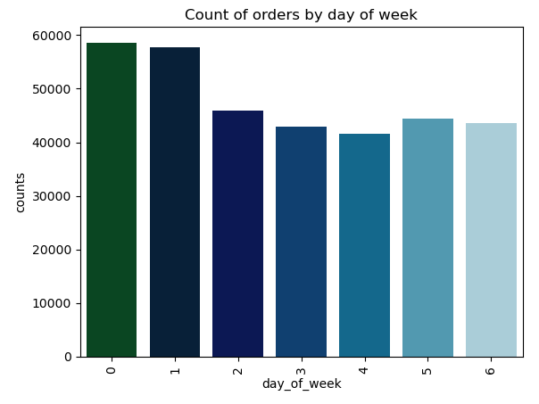
What is the breakdown of orders throughout the week?
Sunday is considered the first day of the week in the United States where Instacart is based in.
Hence, assume that day 1 refers to Sun; day 0 refers to Sat.
More customers place grocery orders during the weekend, compared to other days of the week.
Notes:
### Since Sunday is considered the first day of the week in the United States where Instacart is based in, we assume that day 1 refers to Sunday, and day 0 refers to Saturday.
### We can see from the chart that more customers place grocery orders during the two days of the weekend, compared to the other days of the week.

Slide 12

Market Basket Analysis

Slide 13
Preparing the dataset for market basket analysis
Reference: https://medium.com/@jihargifari/how-to-perform-market-basket-analysis-in-python-bd00b745b106
Main challenge:
Size of dataset
is too big
Final dataset
Reduced no. of orders
Still ran out of memory space -> final dataset restricted to top 1,000 products
Dataset further reduced to 0.5% sample, i.e 5% of 10%
Filter list of products
Initial dataset
49,688 products refined to top 3,000 products (ref. article had 3,844 products). Only orders of these products are retained
Ran out of memory space while trying to use 10% sample

Slide 14



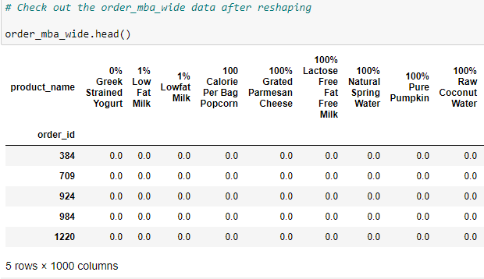
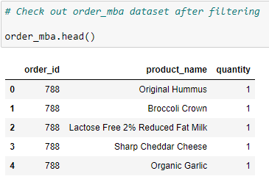
Reshaping of dataset to create one-hot encoded dataset with product names as columns
Reshape data to required wide format for market basket analysis, and keep only order_ids that contain more than 1 item purchased

Slide 15
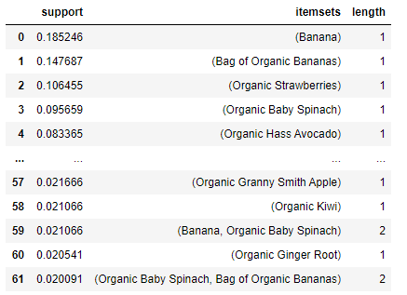
Use apriori algorithm to generate frequent itemsets
Frequent itemsets are itemsets which have a support value >= a minimum threshold
Min support value chosen is 0.02, i.e. the product(s) in itemset constitute at least 2% of all orders
Support value chosen based on trial and error -> initially set at 3% following the reference article, but unable to generate any association rules based on 3% threshold

Slide 16
Key terms and metrics in association analysis (1/2)
Terms/ metrics | Definition
Antecedents and consequents | Association rules are expressed in the form X -> Y. For example, Diapers -> Wet Wipes suggests that customers who buy diapers are also likely to buy wet wipes. In this case, diapers are the antecedent, while wet wipes are the consequent.
Antecedent support and consequent support | Antecedent support computes the proportion of orders that contain the antecedent product, and consequent support computes the proportion of orders that contain the consequent product.
Support | Proportion of orders that contain the combined itemset consisting of both the antecedent product and the consequent product.

Slide 17
Key terms and metrics in association analysis (2/2)
Terms/ metrics | Definition
Confidence | Indicates how likely the X -> Y rule is to be true. For example, if Diapers -> Wet Wipes rule has a confidence value of 0.9, it means that 90% of customers who buy diapers also buy wet wipes at the same time.
Lift | Measures how much more often the antecedent and consequent occur together than we would expect if they were statistically independent. For example, for the Diapers -> Wet Wipes rule, the support for this rule might be 2%, meaning that 2% of orders include both diapers and wet wipes. Let's say that diapers appear in 10% of orders, and wet wipes appear in 5% of orders. The lift can therefore be computed as 0.02 / (0.1 * 0.05) = 4. A higher lift value, particularly over 1, signals a stronger association between the items.

Slide 18
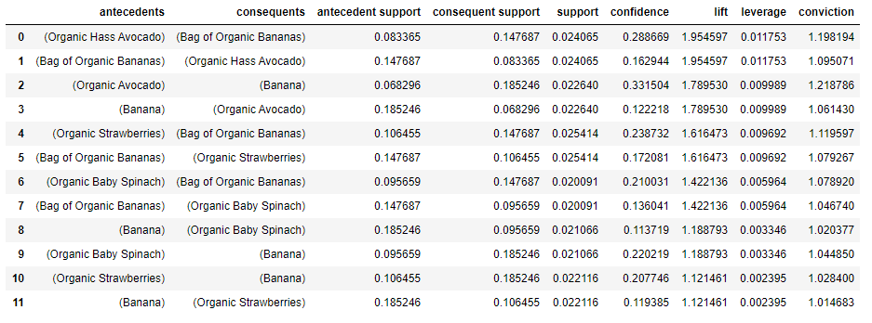
Results from association rule analysis

Slide 19
Interpretation of results
Hypothesis: Smoothie recipes
Organic Hass Avocado -> Organic Bananas
Organic Baby Spinach -> Organic Bananas
Highest lift of nearly 2, confidence of 0.29
Top four association rules are simply different variations of the avocado and banana pairing
Lift value of 1.42 and confidence of 0.21
Fruit and veg
combis could have been purchased for smoothies, with bananas being a popular base fruit
Organic Strawberries -> Organic Bananas
Lift of 1.62 and confidence of 0.24

Slide 20
Recommendations and applications
For easier retrieving and packing of customer orders, the bananas could be put in a central location. Also reminds customers to add other fruit / veg into cart
Positioning of products in store
Bananas paired with avocados, strawberries or spinach could be sold in a bundle at a lower price, encouraging even more sales
Bundling of products for sale
When customers check out with at least one of these items, a recommender prompt could appear to suggest carting out the associated products as well
Recommender engines

Slide 21
Possible extensions
01
02
I was unable to generate the association rules for the entire dataset, with the market basket analysis being limited only to the top 1,000 products on a 0.5% sample. One possible refinement is to look into methods such as parallel computing, so that much bigger datasets can be processed and analysed in an efficient manner without losing information.
Association rules generated can be fed into recommender engines to further improve customers' retail experience. Such recommender engines could be developed if we are able to take into account more products and generate more insights, enhancing grocery shopping for our Instacart users.

